Slide 1

Market Eye: Stock Analysis Dashboard
Group 1

Slide 2


Section 1
The Business Problem Overview

Slide 3
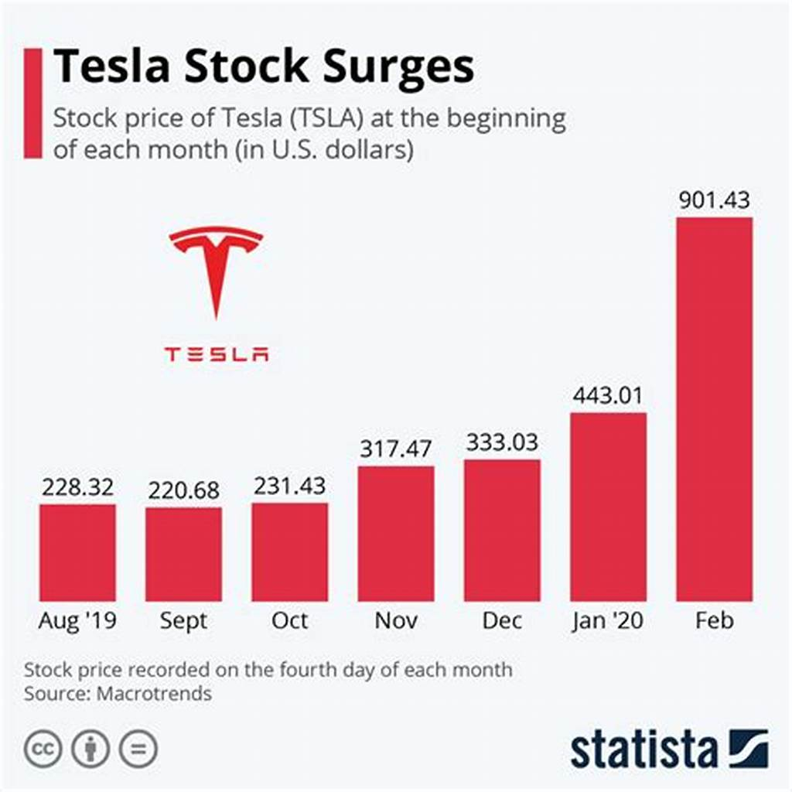
Page 1.1: Problem Statement
Challenges in Data Analysis
Investors face difficulties in efficiently analyzing extensive historical stock data, which hinders their ability to identify trends and make informed decisions, ultimately affecting their investment strategies and potential returns.

Slide 4

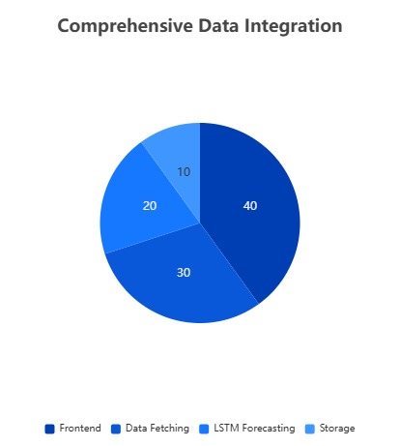
Page 1.2: Market Eye Solution
Comprehensive Data Integration
Market Eye seamlessly integrates multiple data sources, ensuring users have access to a holistic view of market trends and stock performance, which enhances the accuracy of forecasts and supports strategic investment decisions.

Slide 5
Section 2
The System Architecture

Slide 6

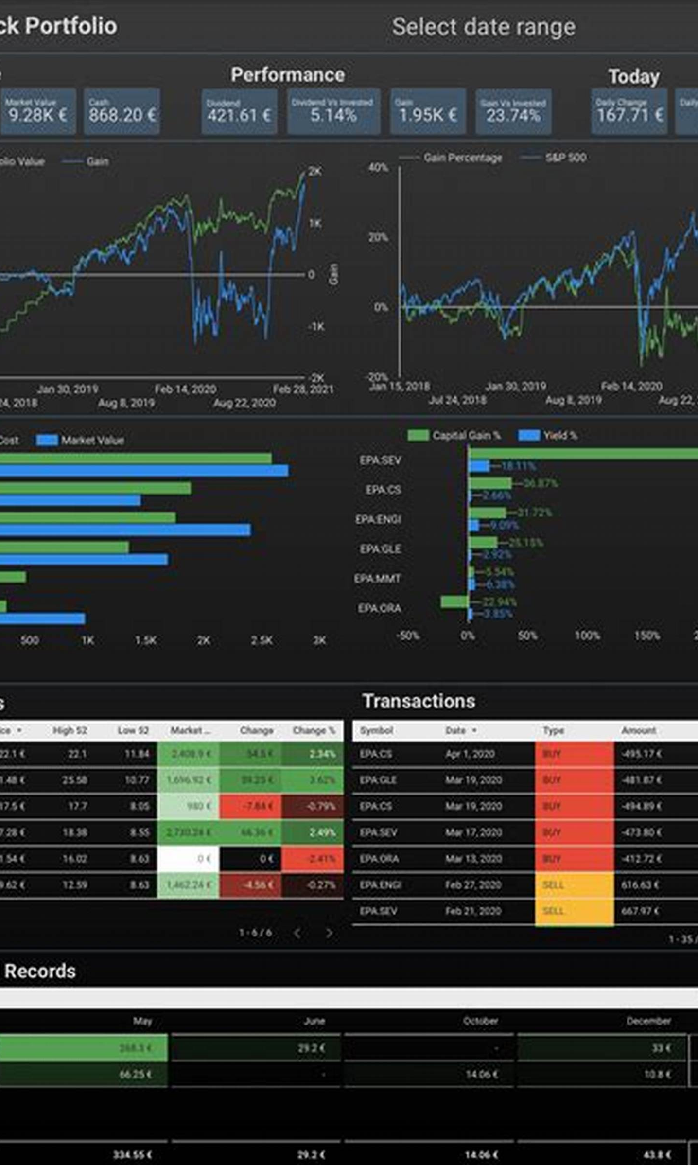
Page 2.1: Components
User-Friendly Interface
Streamlit enhances user engagement through an interactive and visually appealing dashboard design.
Real-Time Data Access
yfinance integration ensures users receive up-to-date stock information for timely decision-making.
Organized Data Management
Structured directories facilitate efficient storage and retrieval of data, forecasts, and reports.

Slide 7


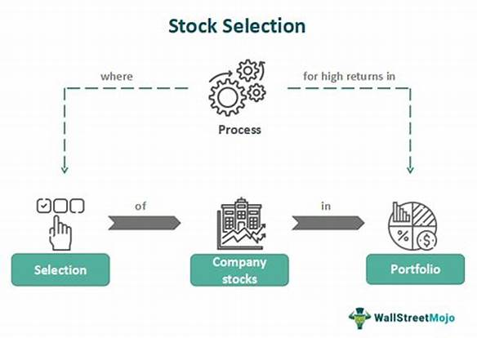
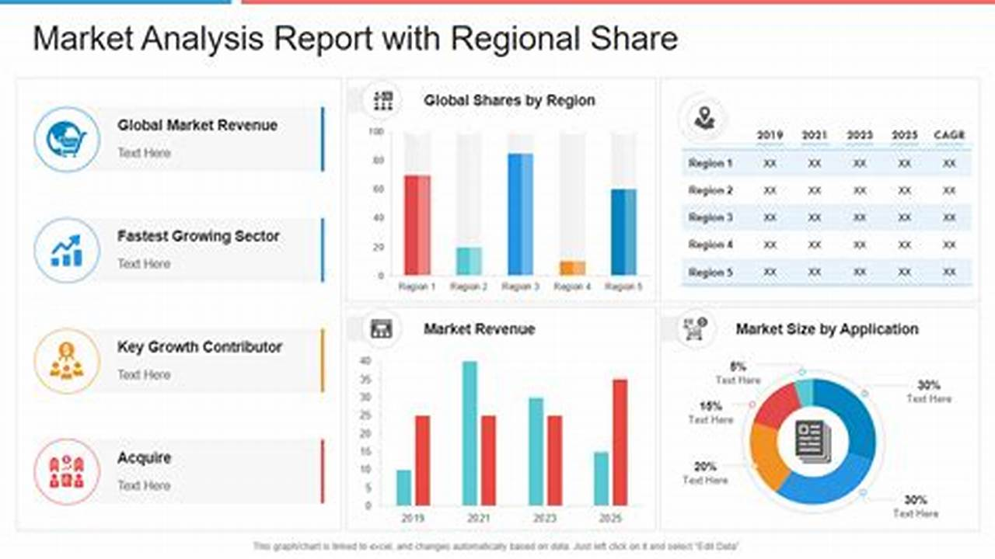

Page 2.2: Workflow
Secure User Authentication
Dynamic Stock Selection
Comprehensive Reporting Features
The login process ensures that only authorized users can access sensitive stock data, enhancing security and protecting user information from unauthorized access.
Users can easily choose from a wide range of stock tickers, allowing for personalized analysis and tailored insights based on individual investment interests and strategies.
The export functionality provides users with detailed PDF reports, summarizing key data and forecasts, which aids in effective communication and decision-making among stakeholders.

Slide 8
Section 3
The Live Streamlit Demo

Slide 9
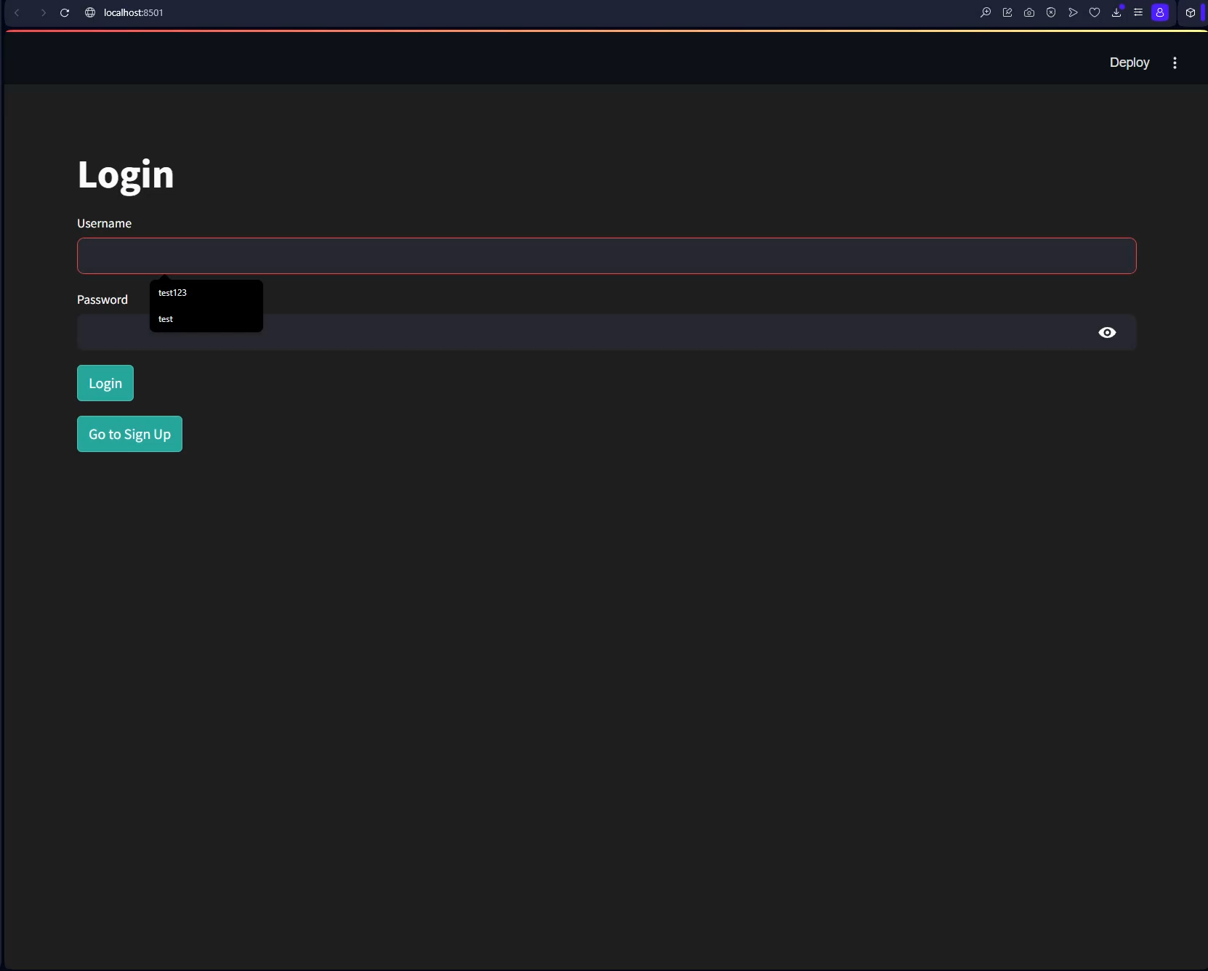

Slide 10



Page 3.1: Demo Highlights
Secure Access Features
Interactive Stock Selection
Advanced Data Visualization
The demo emphasizes robust user authentication, ensuring that sensitive stock analysis data remains protected from unauthorized access.
Users can effortlessly navigate through a variety of stock tickers, enhancing their ability to conduct personalized analyses based on specific interests.
The dashboard showcases multiple chart types, providing users with critical insights into market trends and stock performance for informed decision-making.

Slide 11

Page 3.2: Note
Live Demo Importance
The live demonstration effectively illustrates the Streamlit dashboard's capabilities, showcasing real-time data analysis and user-friendly features for enhanced investor engagement.
User Experience Focus
Emphasizing intuitive navigation and interactive elements, the demo aims to empower users in making informed investment decisions through comprehensive data visualization.

Slide 12
Section 4
The Code Walkthrough Highlights

Slide 13

Page 4.1: Secure Authentication in app.py
Robust Password Security
Implementing bcrypt for password hashing ensures that user credentials are stored securely, significantly reducing the risk of data breaches and enhancing overall application security, thereby fostering user trust and confidence in the platform.

Slide 14
Section 5
The Lessons Learned and Challenges

Slide 15
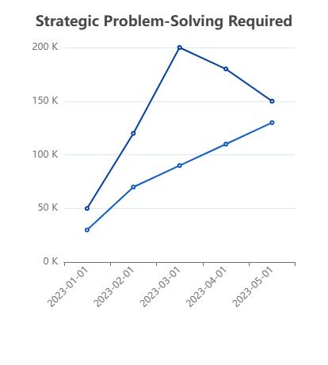
Page 5.1: Challenges
Strategic Problem-Solving Required
The development of the Market Eye dashboard faced significant hurdles, including permission errors in OneDrive, dependency conflicts among libraries, slow LSTM training times, and performance issues under user load, necessitating innovative solutions and adjustments to enhance system resilience and efficiency.

Slide 16
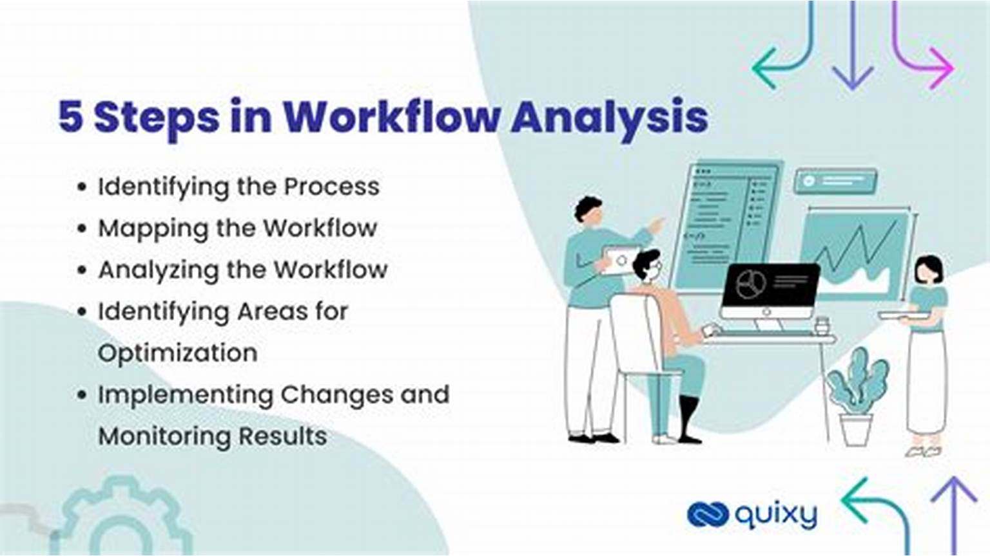
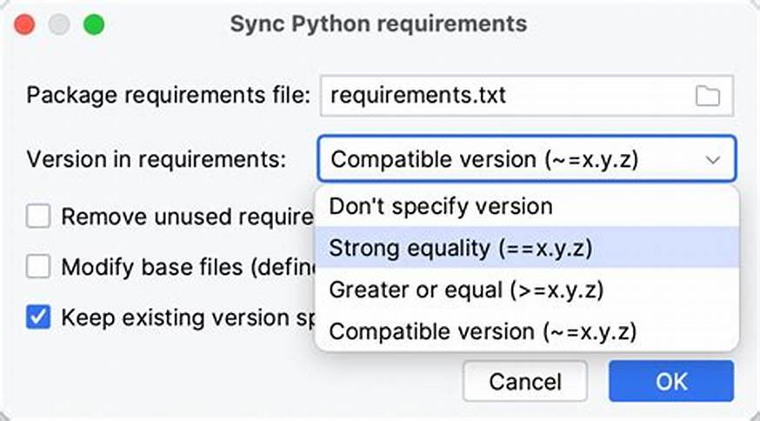
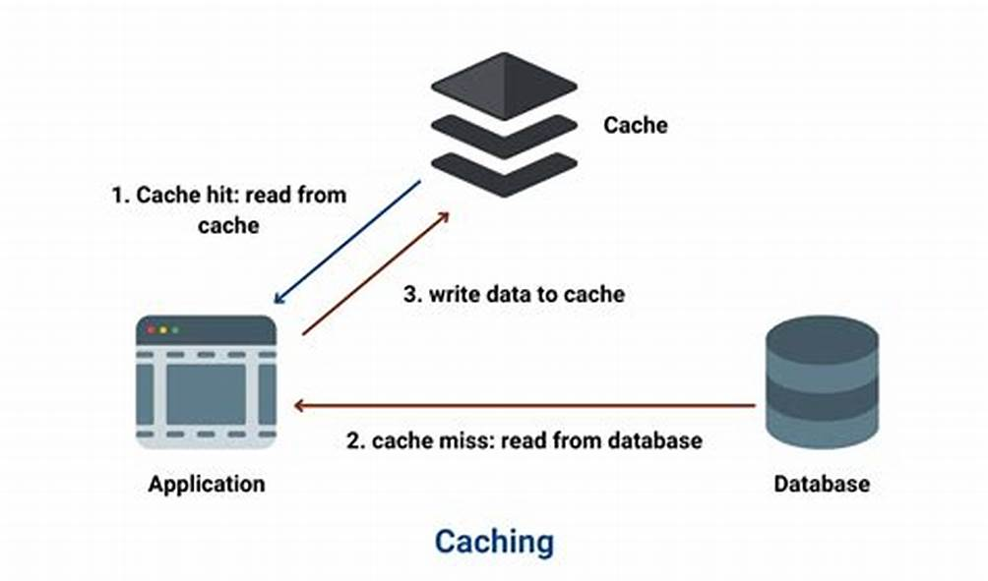
Page 5.2: Lessons Learned
Local Directory Benefits
Version Control Importance
Caching for Performance
Utilizing local directories significantly improved workflow efficiency by reducing permission-related issues, leading to a smoother development process and minimized downtime.
A consistent `requirements.txt` file is essential for avoiding dependency conflicts, ensuring all team members work within the same environment, enhancing project reliability.
Implementing caching in the Streamlit application drastically improved response times, achieving under 10 seconds, which is crucial for user satisfaction in real-time analysis.

Slide 17
Section 6
The Non-Functional Requirements

Slide 18
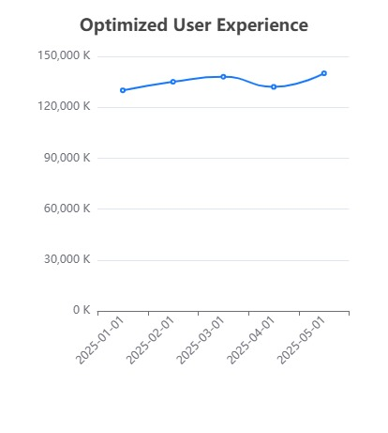
Page 6.1: Performance
Optimized User Experience
Continuous performance enhancements, including advanced caching strategies and efficient data retrieval methods, ensure that users experience minimal delays, fostering a more productive environment for real-time stock analysis and decision-making.

Slide 19






Page 6.2: Usability
01
02
User-Centric Design Approach
Enhanced Interaction Features
The dashboard's layout prioritizes user experience, ensuring that essential features are easily accessible, which enhances overall engagement and satisfaction during analysis.
Interactive elements, such as tooltips and hover effects, provide users with immediate insights, facilitating a deeper understanding of data trends and stock performance.

Slide 20

Page 6.3: Security
Enhanced Data Protection
Audit Trail Capabilities
Regular Security Updates
Implementation of encryption protocols ensures that sensitive user data is securely transmitted and stored, minimizing the risk of unauthorized access.
The system maintains comprehensive logs of user activities, enabling monitoring and analysis of access patterns to detect potential security breaches.
Continuous updates and patches are applied to the application, addressing vulnerabilities and ensuring compliance with the latest security standards and best practices.

Slide 21

Thank You

